Slide 1
October 2024

Slide 2
Sexual Health Key Messages
October 23, 2024
Highest weekly average last week 178 sexual health visits / day Highest number of daily service users on Monday July 8, 2024 at 220 users New visits have stabilized. Our testing is significantly less expensive than Public Health.
Successful Code for Canada Hackathon Idea 1: Improve kiosk check-in process Idea 2: Automate mass sending of all negative results (80% of patients)

Slide 3
Cumulative data on sexual health visit from July 2022 to October 2024
62609 visits 13911 individuals

Slide 4
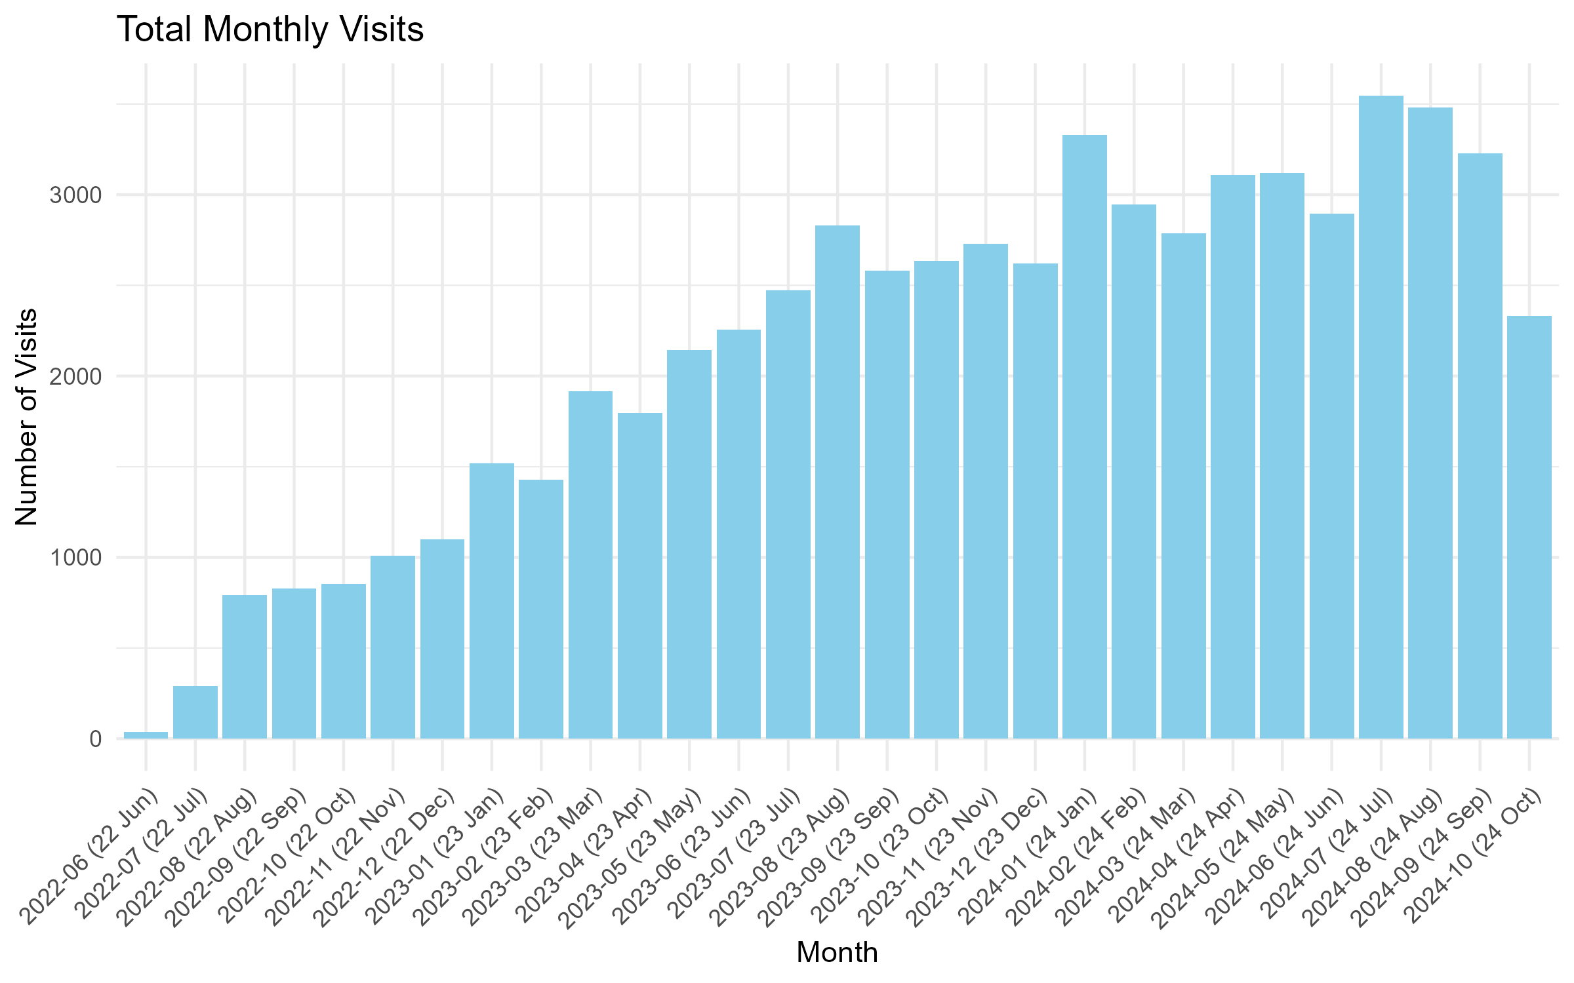
First vs Return July 2023 - June 2024
04,725 visits in 2022 27,025 visits in 2023 18,986 visits in 2024

Slide 5
Demographics July 2022 to October 2024
Average Age: 34
HIV Positive: 10%
Cis Male: 87%
Trans Male: 1%
Trans Woman: 1.6%
Non-Binary: 5.6%
Other Gender: 1.6%

Slide 6
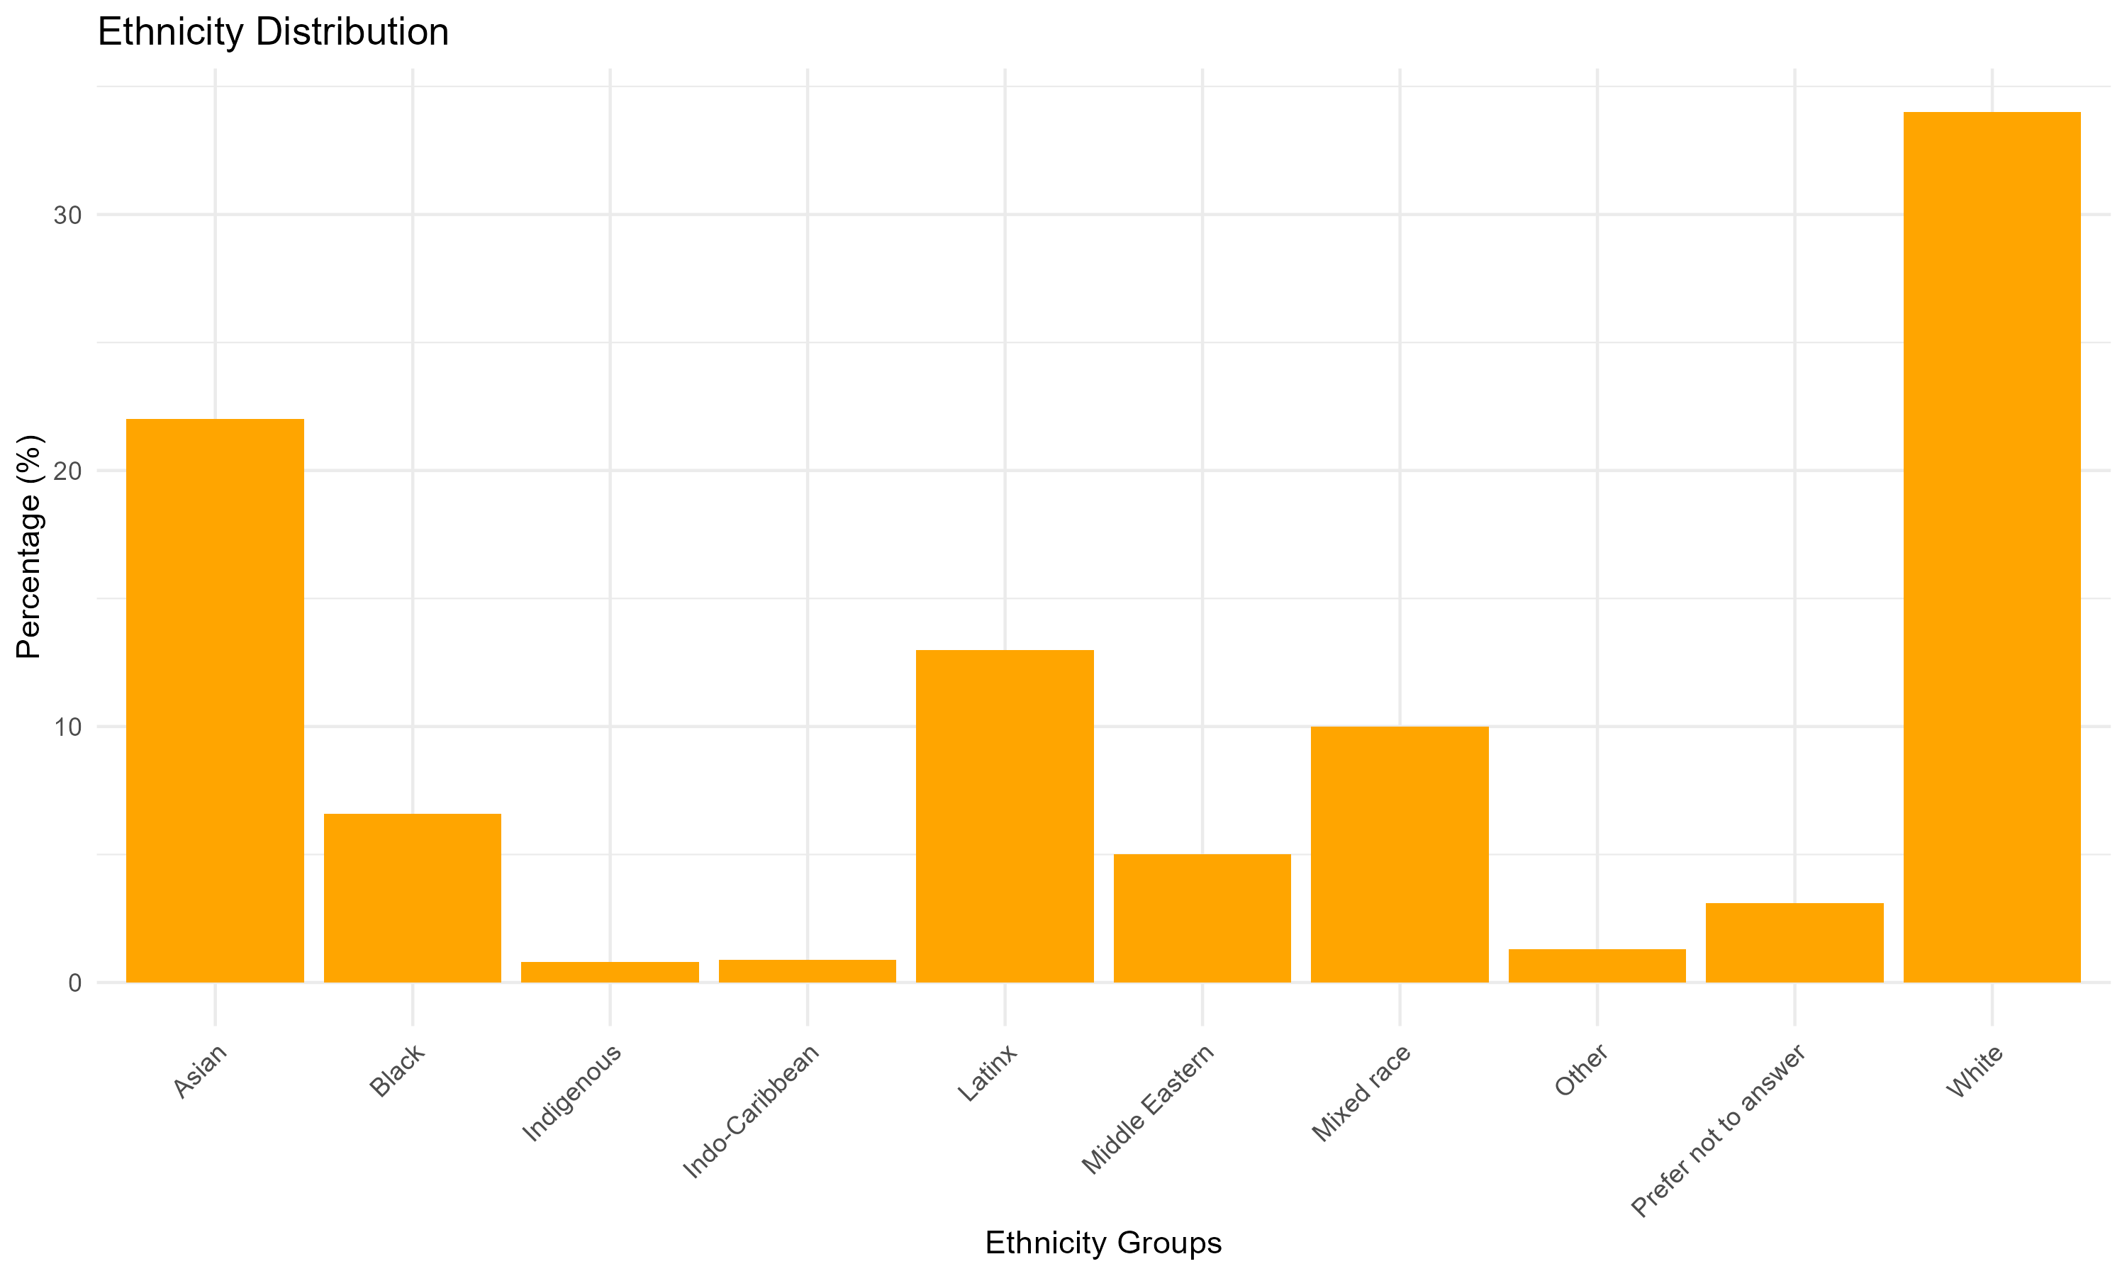
Ethnicity by individuals July 2022 to June 2024

Slide 7
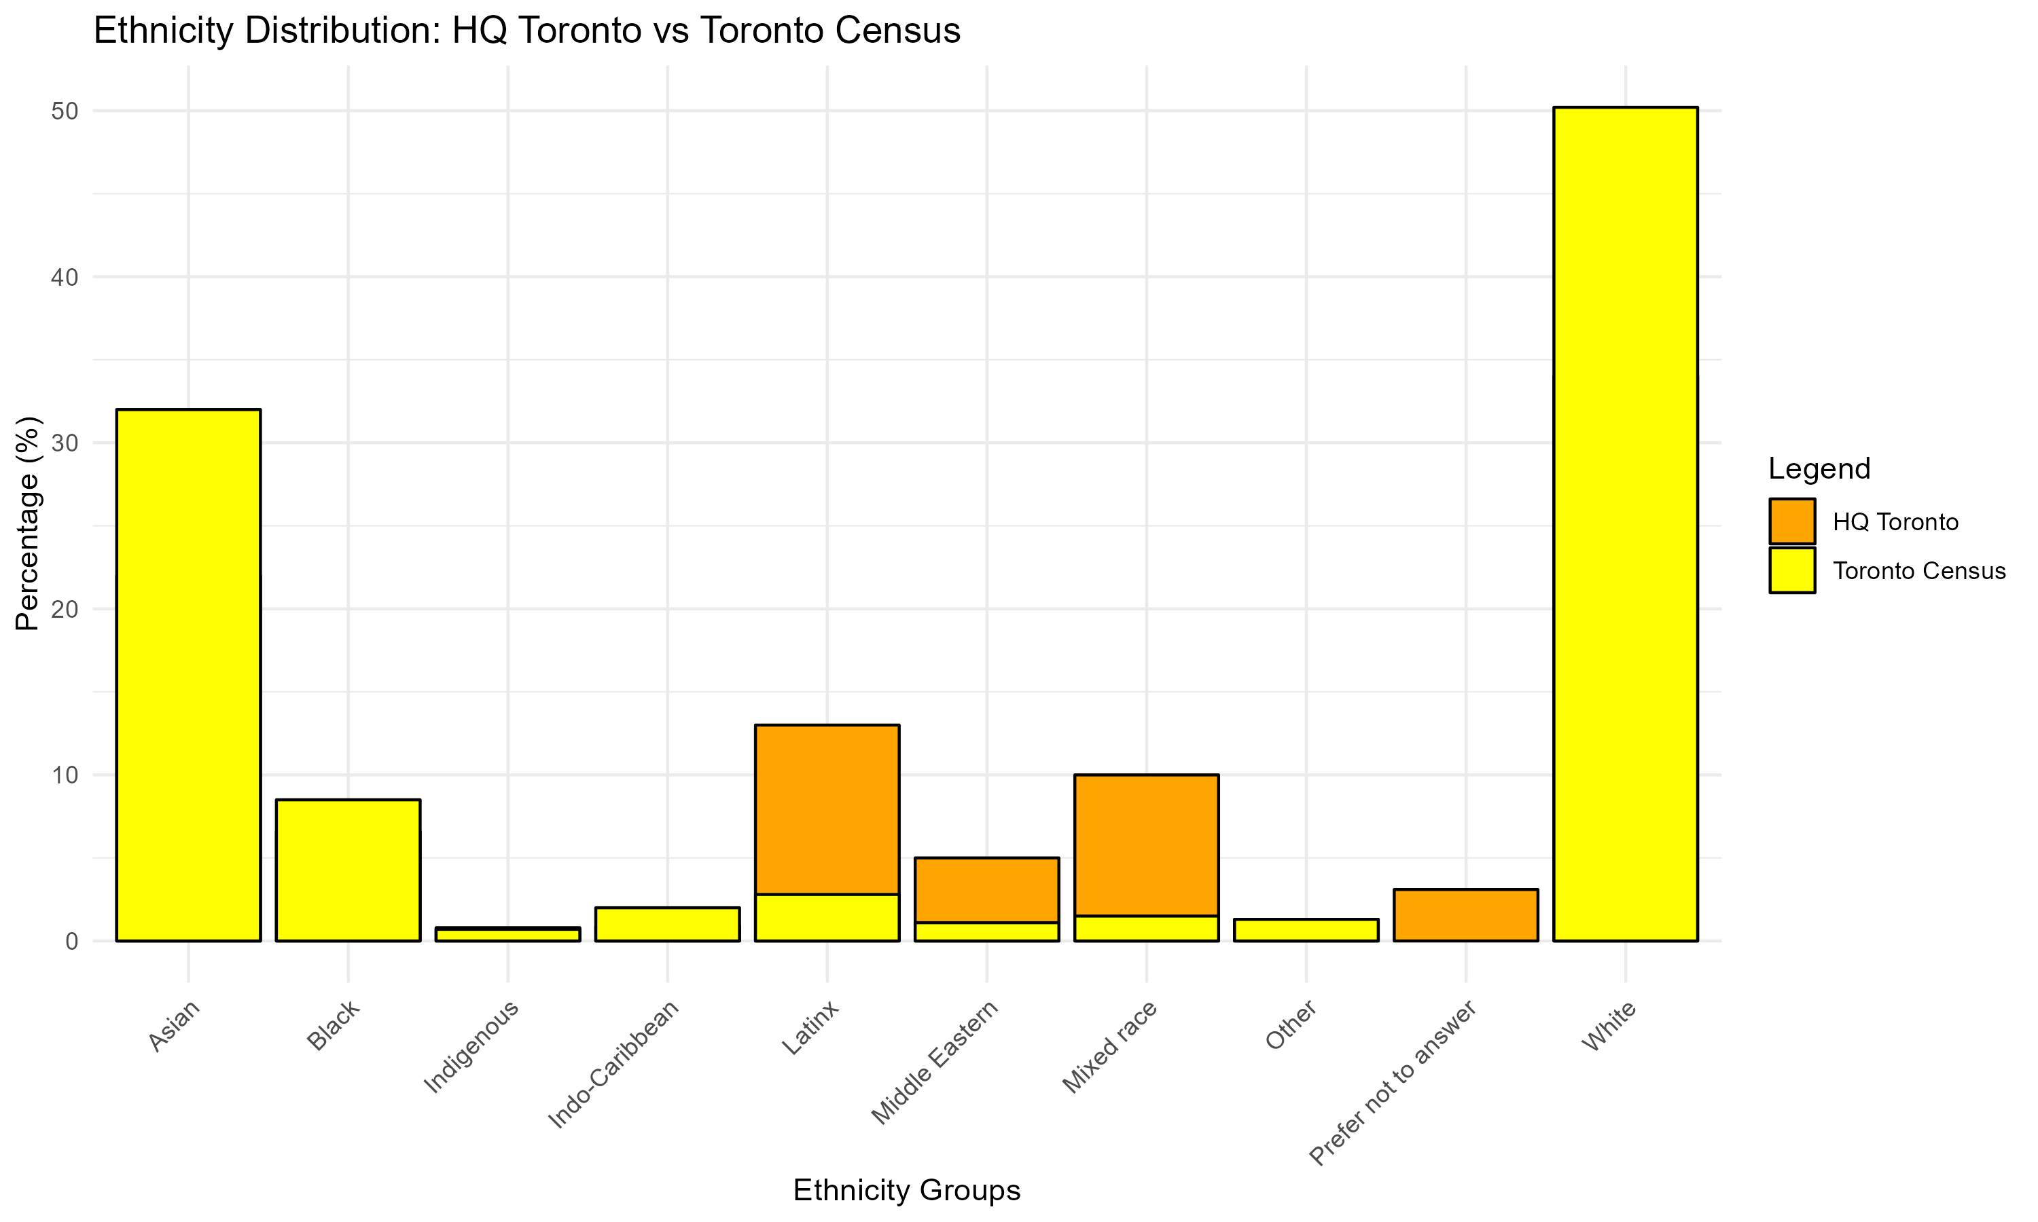
Ethnicity by individuals July 2022 to June 2024

